Slide 1

FieldOps AI
Context-Aware Field Service Management System
Review 1 – Project Progress Presentation
From operational pain to a working software product.
Author: MANOJKUMAR V • Department: Artificial Intelligence & Data Science • Section: B • Register No.: 24102095

Slide 2



The Problem
Traditional dispatching relies on static assumptions and limited visibility. Technicians vary by skill and availability, while ETAs break down under changing conditions (weather, traffic, events, road restrictions). Dispatch decisions are difficult to trust without traceability.
Operational Gaps
Unreliable travel-time, poor situational awareness, manual overrides without accountability.
Dispatch Challenges
Assigning the right technician at the right time is error-prone; planners need contextual ETAs before committing.
Audit & Compliance
Changes must be traceable: who, why, when, and what changed needs an auditable trail.
Need: Combine technician skills, execution state, contextual ETA, and auditable decisions into one platform.

Slide 3

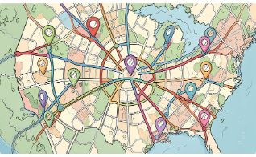
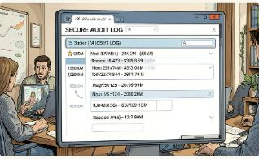
Proposed Solution: FieldOps AI
A context-aware Field Service Management platform that merges role-based workspaces, technician & skills management, GPS-enabled job handling, and a context-aware ETA engine with built-in auditability.
Role-based Workspaces
Contextual ETA Engine
Audit & Overrides
Dispatcher overrides require reason and authorization; every change is recorded for traceability.
Administrator, Dispatcher, Technician views tuned to responsibilities and permissions.
Combines baseline routing with weather, traffic, events and local restrictions to produce actionable ETAs.

Slide 4
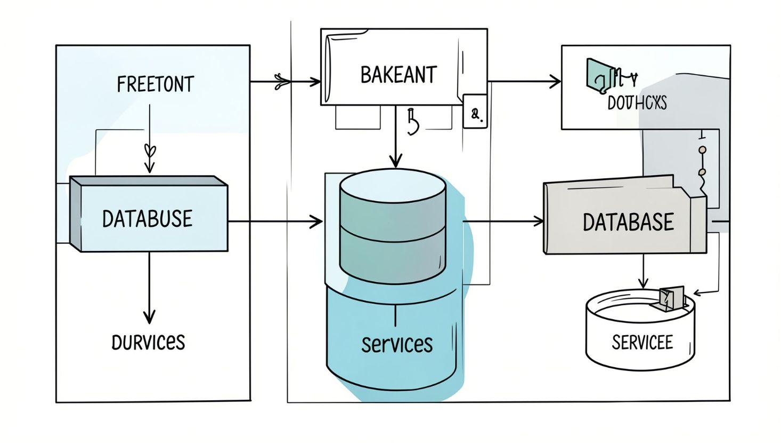

System Architecture
Frontend
React 19 • TypeScript • Vite • Tailwind • React Router • TanStack Query
Backend
Python 3.12 • FastAPI • SQLAlchemy • Pydantic • JWT Auth • RBAC
Database & Core Modules
PostgreSQL + Alembic. Core modules: Users | Technicians | Skills | Jobs | ETA | Overrides | Audit
Designed for testability, role-scoped APIs, and incremental integration of external context sources.

Slide 5




Role-Based Workspaces
Administrator
Manage users, roles, technicians, skills and system visibility; full audit access.
Dispatcher
Job management, ETA analysis, technician directory, availability, and controlled overrides.
Technician
Assigned jobs, customer/location details, job instructions, status transitions, and completion workflow.
One system — three operational views, each enforcing least-privilege and optimized UX for role tasks.

Slide 6

Technician, Skills & Job Management
Centralized CRUD for technicians and skills, search & filters, live availability and GPS locations. Skill categories and technician-skill associations ensure accurate qualification matching.
01
02
03
Job States
Execution Controls
Traceability
ASSIGNED → TRAVELLING → ARRIVED → WORKING → COMPLETED
Ownership checks, status transition validation, completion notes, and mandatory confirmations.
Status changes and notes are audited for accountability and post-incident review.

Slide 7





Context-Aware ETA Engine
Baseline ETA = Haversine distance / nominal speed (40 km/h) + staging buffer. Context-aware ETA augments baseline with adjustments from weather, traffic, events and road restrictions when available.
1
2
Baseline ETA
Context Adjustments
Haversine → 40 km/h → +3 min staging (deterministic, explainable)
Weather (+/-), traffic (+), events (+), road closures (+). Integration planned for live feeds where available.
3
Example
Baseline: 7 min • Weather adj: +5 min • Context-Aware ETA: 12 min
Current integrations: GPS & Weather available. Traffic, events, and road restrictions are next integration priorities.

Slide 8


Override & Auditability
Dispatcher Override
Overrides are supported but controlled: dispatcher/admin authorization required, reason mandatory, and every override stored in history.
Dispatcher inputs ETA and mandatory reason
System Log
Records actor, timestamp, and details
Audit Review
Accountability: every operational decision is explainable and traceable to support SLAs and dispute resolution.
Full override history available for review
1
2
Override Policy
Audit Trail
Role-based permissions, mandatory justification, and preview of downstream impacts before commit.
Actor → Action → Entity → Old Value → New Value → Reason → Timestamp — immutable log for reviews and compliance.

Slide 9

Testing & Current Progress
10/10
12/12
15/15
Technician Management
Skills Management
Job Execution
All unit & integration tests passed.
Complete coverage and validations.
State transitions and safeguards verified.
17/17
0
ETA Engine
Frontend Type Check
Baseline and context-adjustment logic unit-tested.
TypeScript checks: 0 errors — build-ready.
Demonstrable flow: Authentication → Role Dashboards → Technician/Skills → Job Execution → ETA → Dispatcher Override → Audit.
Review 1 Progress: ~35% — a working, test-verified foundation ready for real-data integrations and stakeholder validation.

Slide 10
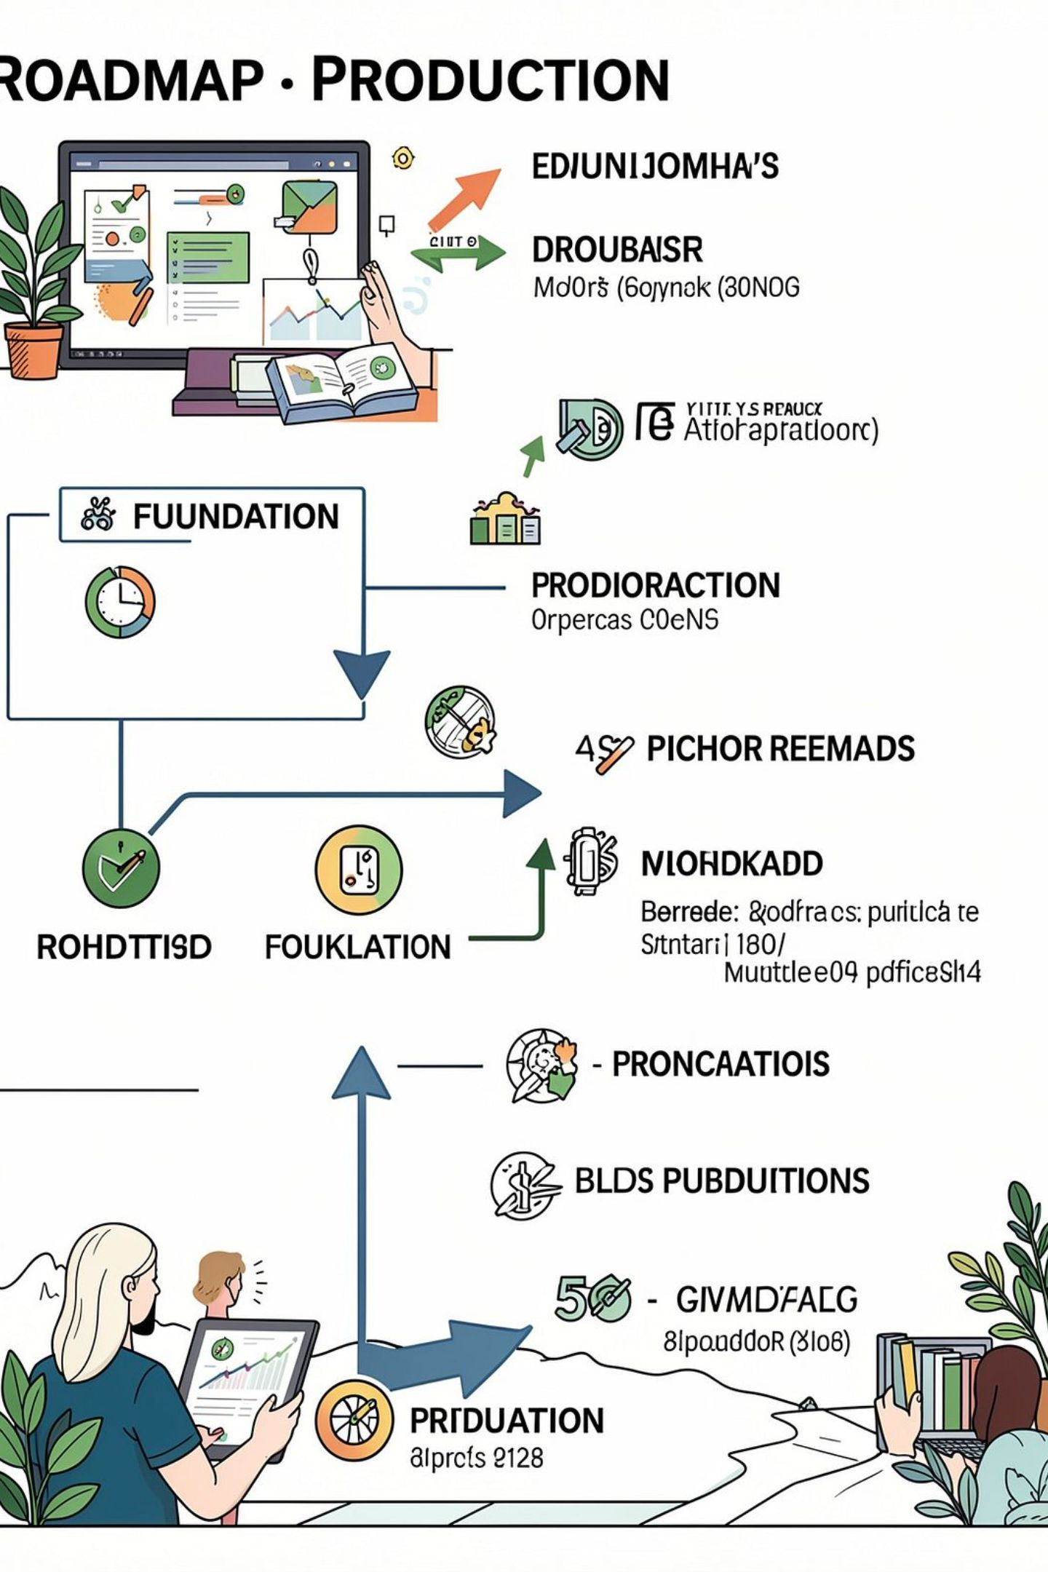
Remaining Work & Next Phase
1
Integrations
Live traffic, event feeds, and road-restriction data; real road-network routing.
2
Validation
Baseline vs Context ETA experiments with historical data; non-routine error analysis; 3+ failure scenario tests.
3
Stabilization
Unified end-to-end dispatch pipeline, user/stakeholder validation, final regression testing.
4
Production Readiness
Deployment automation, monitoring, SLA instrumentation, and handoff plan for operations.
Road to completion: Working foundation → Real data integration → Measured ETA performance → Complete dispatch workflow → Production-ready FieldOps AI.
Thank you — ready for questions and the next milestone planning session.

